Slide 1

MSc. In Data Science and Analytics
DSA 8401: Applied Machine Learning Assignment
106218 - Gertrude Gichuhi
Housing Project
28th/08/2022

Slide 2
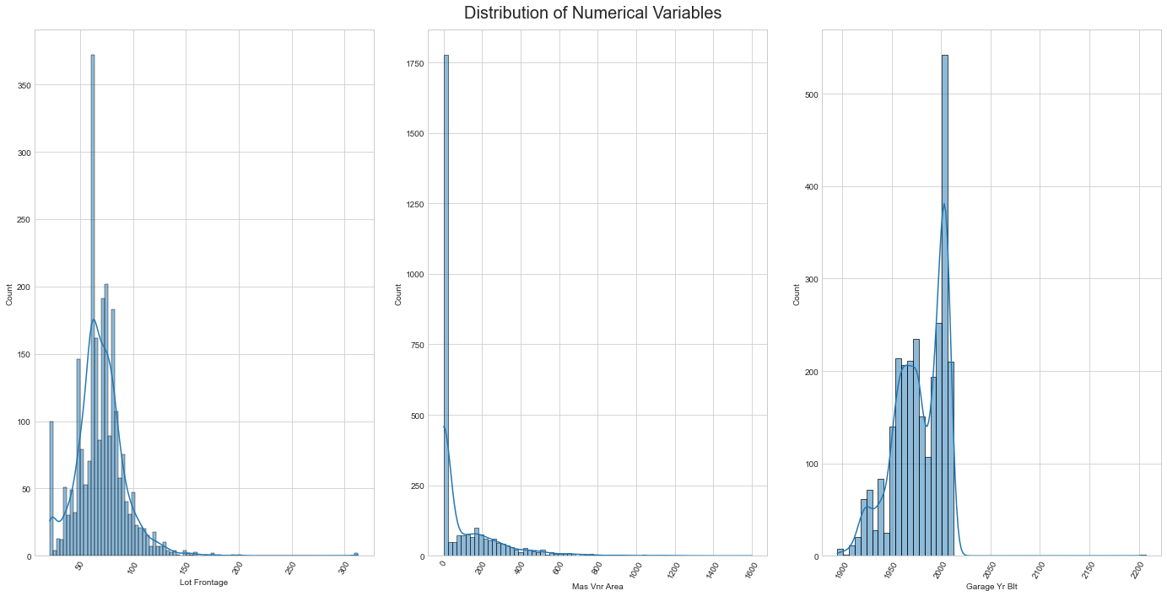
Understanding the Data & Performing EDA
General information about the dataset
Shape -The Dataset has 2930 rows and 82 columns
After examining columns Order and PID, I conclude that they can be used since they act as the Metadata, meaning they are the input elements that describe things, answering questions such as when it was bought etc.

Slide 3
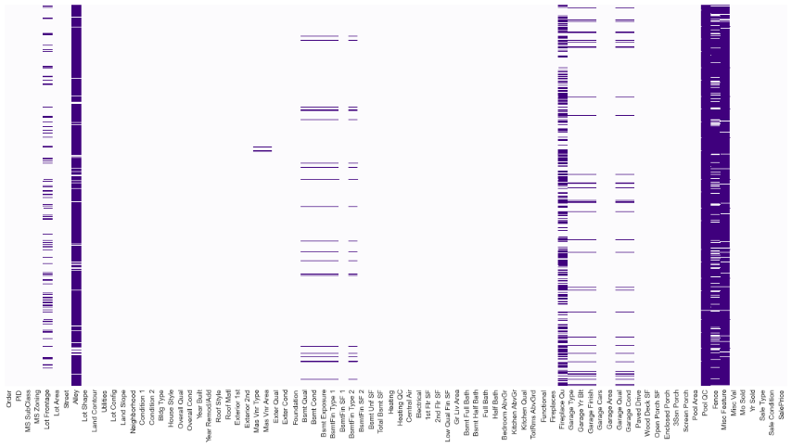
Feature Analysis
Missing Values in both Numerical and Categorical
Shape -The Dataset has 2930 rows and 82 columns

Slide 4

Feature Analysis
Missing Values in both Numerical and Categorical
Shape -The Dataset has 2930 rows and 82 columns
After examining columns Order and PID, I conclude that they can be used since they act as the Metadata, meaning they are the input elements that describe things, answering questions such as when it was bought etc.

